Slide 1
Microsoft SQL Server 2025 - kolejna wersja, ale czy warto z niej skorzystać?
Michał Sadowski

Slide 2
Agenda
Wprowadzenie
Nowe funkcje dla deweloperów
Ulepszenia wydajności i zarządzania
Nowości w analizie i integracji danych
Zabezpieczenia i zarządzanie tożsamościami
Podsumowanie oraz Q&A

Slide 3




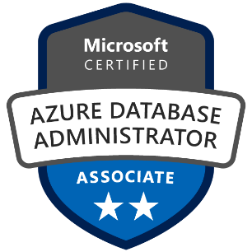

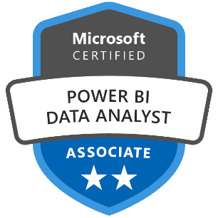





Kilka słów o mnie
Architekt chmurowych platform danych opartych o Microsoft Azure
Ponad 18 lat doświadczenia w IT (administracja Windows Server, MS SQL Sever, Microsoft Azure)
Lider krakowskiej grupy Data Community PL
Główne zainteresowania:
Optymalizacja wykorzystania infrastruktury
Migracja do najnowszych wersji (lokalnie i w chmurze)
Partner Loxone – rozwiązania Smart Home
Prywatnie fan motoryzacji i biegania ;)
Solutions Architect
Algomine /
Transition Technologies PSC Kraków, Polska
Michal.Sadowski@hotmail.com
https://aka.ms/michal

Slide 4
Wprowadzenie
Microsoft zaprezentował nową wersję SQL Server na konferencji PASS Summit 2025 Microsoft Iginite
Zastanowimy się dlaczego warto rozważyć nową wersję
Omówimy kluczowe zmiany w porównaniu do poprzednich wersji
Na praktycznych przykładach pokaże jak wykorzystać nowości

Slide 5
Dlaczego warto skorzystać z SQL 2025?
Obniżenie kosztów infrastruktury
Utrzymanie wsparcia dla aplikacji korzystających z baz danych
Zapewnienie wyboru i nowych funkcjonalności dla klientów
Okazja aby zmodernizować sprzęt oraz aplikację

Slide 6
Microsoft SQL Server ™ Analytics Performance SF @ 3TB
Comparing 5th Gen EPYC vs 5th Gen Xeon – MEDIUM (16 cores and 32 cores / node)
TPC-H Perf @ 16 or 32 cores per node (Higher is better)
Software License cost* (16c-32c) for 10M Queries (Lower is better)
~23%
savings
~37%
savings
*https://www.microsoft.com/en-us/sql-server/sql-server-2022-pricing As of 5/2/2025
Testing conducted internally by AMD and is comparable to published TPC-H benchmark results. See AMD Endnote 9xx5-221
Notes:
What we are showing here are several common use cases for CPU based inference – from Classical Machine Learning, Recommendation systems, Generative AI, and Large Language model inference.
On machine learning, which is a workload with strong CPU affinity, you can see an impressive 2.9x perf vs competition and an impressive generational bump as well.
On end-to-end AI pipelines which include data prep, data generation, data load, training and inference, represented by TPCx-AI, EPYC delivers an even more impressive 3.8x perf vs competition.
So that’s a quick summary of performance delivered by 5th gen EPYC while running AI workloads on the CPU alone.

Slide 7
Wsparcie dla produktów Microsoft
Wsparcie podstawowe (Mainstream support) obejmuje aktualizacje funkcjonalności, wydajności, skalowalności i zabezpieczeń – 5 lat
Wsparcie rozszerzone (Extended support) obejmuje wyłącznie aktualizacje zabezpieczeń – 5 lat
Rozszerzone aktualizacje zabezpieczeń (Extended Security Updates) - 3 lata

Slide 8
Wersja MS SQL | Data wydania | Wsparcie podstawowe | Wsparcie rozszerzone | Rozszerzone aktualizacje zabezpieczeń
SQL Server 2025 | 2025-11-19* | 2030-11-19* | 2035-11-19* | 2038-11-19*
SQL Server 2022 | 2022-11-16 | 2028-01-11 | 2033-01-11 | 2036-01-11*
SQL Server 2019 | 2019-11-04 | 2025-02-28 | 2030-01-08 | 2033-01-08*
SQL Server 2017 | 2017-10-02 | 2022-10-11 | 2027-10-12 | 2030-10-12*
SQL Server 2016 | 2016-06-01 | 2021-07-13 | 2026-07-14 | 2029-07-17
SQL Server 2014 | 2014-06-05 | 2019-07-09 | 2024-07-09 | 2027-07-12
SQL Server 2012 | 2012-05-20 | 2017-07-11 | 2022-07-11 | 2025-07-08
SQL Server 2008 R2 | 2010-06-20 | 2014-07-08 | 2019-07-09 | 2023-06-11
SQL Server 2008 | 2008-11-06 | 2014-07-08 | 2019-07-09 | 2023-06-11
SQL Server 2005 | 2006-01-14 | 2011-04-12 | 2016-04-12

Slide 9
Wersja MS SQL | Wersja silnika | Poziom zgodności | Wspierane poziomy zgodności
Azure SQL DB/MI | 17/16* | 170/160 | 170, 160, 150, 140, 130, 120, 110, 100
SQL Server 2025 | 17.X | 170 | 170, 160, 150, 140, 130, 120, 110, 100
SQL Server 2022 | 16.X | 160 | 160, 150, 140, 130, 120, 110, 100
SQL Server 2019 | 15.X | 150 | 150, 140, 130, 120, 110, 100
SQL Server 2017 | 14.X | 140 | 140, 130, 120, 110, 100
SQL Server 2016 | 13.X | 130 | 130, 120, 110, 100
SQL Server 2014 | 12.X | 120 | 120, 110, 100
SQL Server 2012 | 11.X | 110 | 110, 100, 90
SQL Server 2008 R2 | 10.50.x | 100 | 100, 90, 80
SQL Server 2008 | 10.0.x | 100 | 100, 90, 80
SQL Server 2005 | 9.X | 90 | 90, 80, 70

Slide 10










SSMS 22
aka.ms/ssms
Generally Available
SQL Server 2025 support
Fabric integration
GitHub Copilot (Preview)
Windows ARM64 support
Migration Assistant
Query Hint Recommendation tool
New themes including dark
JSON viewer
Zoom results grid
Notes:
30 secs

Slide 11






















SQL Server 2025
The AI-ready enterprise database from ground to cloud
AI built-in
Develop modern
data applications
Integrate your data
with Fabric
Secure by default
Mission critical engine
Connected
with Arc
Assisted by Copilots
Benchmark
leader
Optimized for
latest hardware
Built for all
platforms
Notes:
Bob to cover

Slide 12
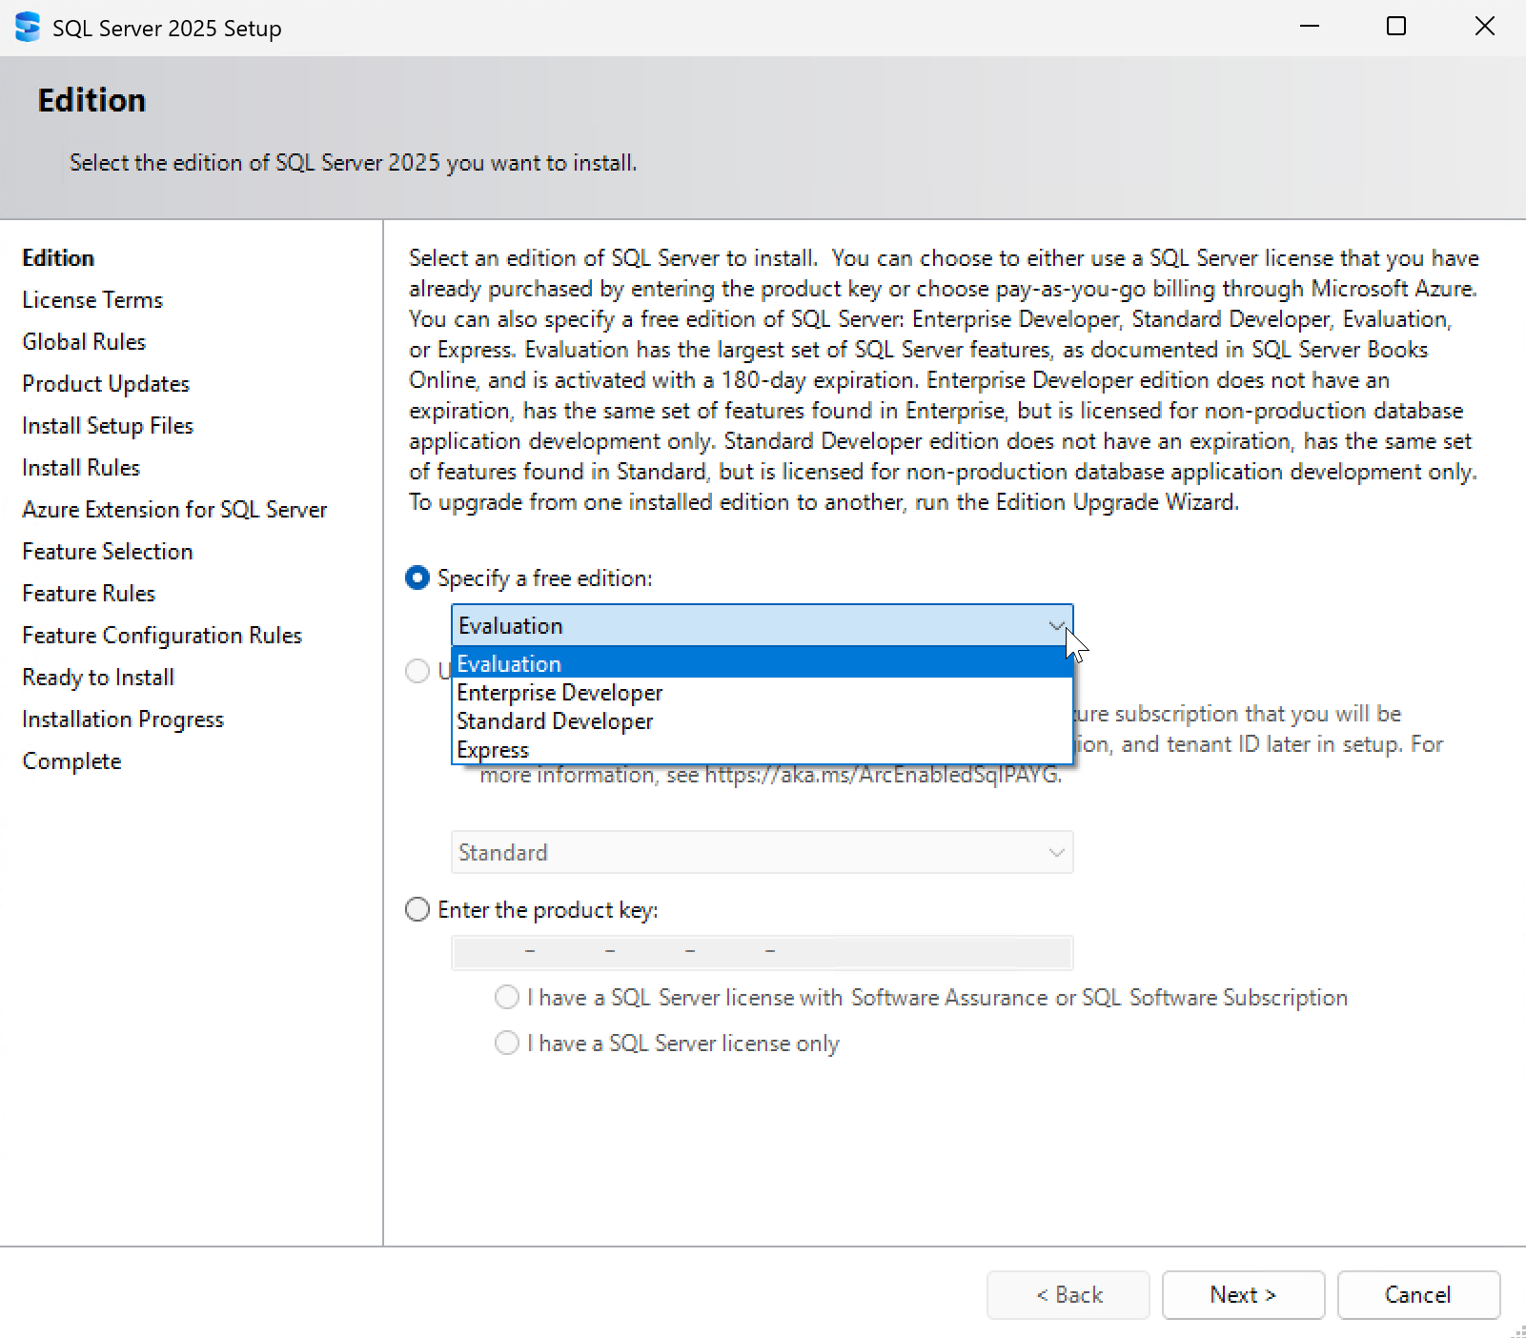
Nowe darmowe edycje SQL Server
Edycje Standard Developer umożliwia testowanie aplikacji, która będzie korzystać z wersji Standard
Nie jest wymagana licencja
Wszystkie funkcjonalności wersji Standard

Slide 13



No pricing or licensing changes
SQL Server 2025 editions
The AI-ready enterprise database from ground to cloud
Express
Free, entry-level database for small AI, web and mobile apps
Standard
Full featured database with extensive scale for mid-tier applications
Enterprise
Highest performance and scaling for business-critical workloads
Feature highlights
50 GB maximum relational databases size
Up to 4 cores of CPU
Up to 1410 MBs of memory
Built-in vector search and semantic search
Native JSON type support
External REST endpoint invocation
Change event streaming
Microsoft Entra ID authentication
Mirroring in Fabric
Feature highlights
Feature highlights
NEW
+ Express features
+ Express and Standard features
Up to 32 cores of CPU
Up to 256 GB of memory
Optimized locking
Resource Governor
ZSTD Backup Compression Algorithm
Basic Availability Groups
Azure SQL Managed Instance link
Accelerated Database Recovery
Backups to S3-compatible object storage
524 PB maximum relational databases size
Highest core count supported
Highest memory supported
Built-in Intelligent Query Processing
Online and Resumable Index Operations
Availability Groups: including distributed and contained
Query Store for readable secondaries
Persisted Statistics for Secondary Replicas (Query store)
NEW
NEW
NEW
NEW
NEW
NEW
NEW
NEW
NEW
NEW
NEW
Developer
Free to use for dev/test in non-production environments
Standard Developer
Enterprise Developer
NEW

Slide 14
Nowe funkcjonalności dla deweloperów
Format danych JSON oraz indeksowanie JSON
ISJSON, JSON_VALUE, JSON_QUERY, JSON_MODIFY
Wrażenia regularne w T-SQL
REGEXP_LIKE, REGEXP_REPLACE, REGEXP_SUBSTR, REGEXP_INSTR, REGEXP_COUNT, REGEXP_MATCHES, REGEXP_SPLIT_TO_TABLE
Wywołanie zewnętrznego punktu końcowego REST
sp_invoke_external_rest_endpoint
Rozmyte dopasowanie ciągów
EDIT_DISTANCE, EDIT_DISTANCE_SIMILARITY, JARO_WINKLER_DISTANCE, JARO_WINKLER_SIMILARITY

Slide 15

JSON
< SQL Server 2025
SQL Server 2025
varchar/nvarchar column
Any index that supports varchar/nvarchar
Various functions for JSON
json data type – binary storage up to 2GB
.modify operator
json index
+ JSON_OBJECTAGG and JSON_ARRAYAGG
+ JSON_CONTAINS
+ JSON_QUERY WITH ARRAY WRAPPER
Save space with compressed storage
Less I/O and page reads
Notes:
1 min

Slide 16

REST in the engine?
Off by default
Securely avoid roundtrips to send data to a REST endpoint
What is the REST protocol for your endpoint? curl.exe is your friend…so is Copilot
EXECUTE @returnValue = sp_invoke_external_rest_endpoint
[ @url = ] N'url’
[ , [ @payload = ] N'request_payload’ ]
[ , [ @headers = ] N'http_headers_as_json_array' ]
[ , [ @method = ] 'GET' | 'POST' | 'PUT' | 'PATCH' | 'DELETE' | 'HEAD' ]
[ , [ @timeout = ] seconds ]
[ , [ @credential = ] credential ]
[ , @response OUTPUT ]
[ , [ @retry_count = ] # of retries if there are errors ]
HTTPS local or remote
This is the crucial piece
API key, SAS token, managed identity
NVARCHAR but often JSON
HTTP_EXTERNAL_CONNECTION wait
Notes:
2 mins

Slide 18
Mission Critical Engine Performance and Availability for your modern database
Improve Concurrency
Accelerate Performance
Increase HADR
Optimized Locking
Abort Query Hint
Tempdb resource governance
IQP enhancements
Columnstore indexes
Query store on read replicas
Reliable Failover for AGs
AG Tuning and diagnostics
Backup enhancements
Industry proven engine
Notes:
So if you are more interested in the core engine, let’s take a look at what is coming with SQL Server 2025. ​
​
Optimized Locking - Literally, forget about lock escalation. The optimized locking which exists in the cloud for Azure SQL today uses a technology to allow you to avoid lock escalation scenarios and excessive lock memory scenarios. There is hands-free lock management built in now to the engine, and that's going to come for SQL Server 2025. ​
What about performance? There is a lot coming here. ​
Behind the scenes, a lot of your queries are powered by something called Batch Mode that you don't even know is happening – especially for aggregate-type queries or to scan large amounts of data. This works both for columnstore and for rowstore scenarios. So we've got improvements in that batch mode area. ​
There are several enhancements for columnstore indexes, including the ability to do better-ordered indexing and improvements for columnstore performance, in general. ​
For queried processing there has been a lot of progress in areas like intelligent query processing, which helps your queries run faster with no code changes required. More improvements are coming here. ​
There are some enhancements to the Parameter Sensitive Plan Optimization functionality.​
There is the ability to persist statistics on secondaries with Query Store now which is exciting for your read queries on replicas. ​
And in addition to that, there's some other enhancements to help you make your queries run faster with built-in query processing.​
Everything in this space is going to be done to make sure you get faster with no code changes required. ​
Finally there are some enhancements coming in query execution as well. ​
Availability: Microsoft has had lot of feedback in this area from a wide range of customers. While they love always on availability groups, there are several situations where they get stuck in a not synchronizing state, and have to manually intervene. With SQL Server 2025 there will be enhanced the algorithms inside availability groups to make sure you get a very reliable failover in those types of scenarios​
​
There is a lot more coming! And Microsoft will share more over the course of this calendar year .

Slide 19
Ulepszenia związane z wydajnością
Optimized Locking
Tempdb space resource governance
Accelerated Database Recovery (ADR) in tempdb
Persisted stats for readable secondaries
Change tracking cleanup
Columnstore index maintenance
CE feedback for expressions
Optional parameter plans optimization
DOP feedback on by default
Query store for readable secondaries
ABORT_QUERY_EXECUTION query hint
Optimized sp_executesql
Batch mode optimizations
Remove In-Memory OLTP from a database
tmpfs support for tempdb in Linux

Slide 21
Ulepszenia związane z bezpieczeństwem
Security cache improvements
OAEP support for encryption
PBKDF password hashing
Authentication using system-assigned managed identity
Backup to URL with managed identity
Managed identity support for EKM
Managed identity for AI models
Entra logins with nonunique display names
Custom password policy on Linux
TDS 8.0/TLS 1.3 support for tools

Slide 22
Secure by default Provide the latest security capabilities for your data
Protected by
Microsoft Defender
outbound
inbound
Managed Identity
Enabled by
Azure Arc
Notes:
Bob to cover

Slide 23



Go passwordless with a Managed Identity
Microsoft Entra
Azure AI
Foundry Model
System Assigned
Managed Identity
API Key
NEW Azure Portal support
“12345abcde67890xyz12345abcde67890”
Azure Arc
DATABASE
SCOPED
CREDENTIAL
EXTERNAL MODEL or
sp_invoke_external_rest_endpoint
Notes:
Bob to cover

Slide 24











The SQL Server 2025 Platform Architecture
Azure AI Agent
Azure
Microsoft Fabric
Microsoft Entra
Foundry Models
Azure Functions
Azure EventHub
Managed Identity
Embeddings
Mirroring
Change Event Streaming
Azure Arc
Reliable Failover
Query Store
Tuning
Diagnostics
Backups
Data API Builder
GraphQL
Vectors
JSON
RegEx
Concurrency
Performance
Security
Availability Group
Ai Agents
Secondary Replica
Agent framework
Managing the Server
SQL Server 2025
sp_invoke_external_rest_endpoint
GitHub Copilot
Local Dev Container
Embeddings
SSMS with Copilot
Local
REST service endpoint
Agentic RAG
AI Agents
Local AI Models
VS Code mssql

Slide 25
Podsumowanie
Dzięki nowym funkcjom, takim jak zoptymalizowane blokowanie, zaawansowane narzędzia agregujące i tekstowe, wsparcie dla JSON oraz wyrażeń regularnych, SQL Server 2025 pozwala na szybsze i bardziej efektywne przetwarzanie danych, co przekłada się na lepszą wydajność aplikacji i analizy biznesowe.
Dodatkowo, nowe mechanizmy zabezpieczeń i długoterminowe wsparcie produktu gwarantują ochronę danych oraz stabilność systemu przez wiele lat.
Integracja z chmurą i elastyczność architektury umożliwiają łatwe dostosowanie infrastruktury do zmieniających się potrzeb biznesowych.

Slide 26









Call to Action
Check out our blogs
aka.ms/Build/sql2025blog
Download it today
aka.ms/getsqlserver
Read the docs
aka.ms/sqlserver2025docs
Get the decks
aka.ms/sqlserver2025decks
Get the demos
aka.ms/sqlserver2025demos
Give us your feedback
aka.ms/sqlfeedback
https://aka.ms/ssms-feedback
Learn from our videos
aka.ms/Build/sql2025mechanics
aka.ms/SQL2025videos
Upgrade to the new SSMS 22 and Copilot
aka.ms/ssms22
Be more efficient with GitHub Copilot
aka.ms/vscode-mssql-copilot
Notes:
Erin to cover
(I can get a black SSMS icon and black Copilot icon if needed)
Also, I removed colons ( : ) from each entry…if you hate it I can add them back ☺

Slide 27
Q&A

Slide 28
Pytania do Was:
Jaki jest najniższy poziom zgodności bazy danych (compatibility level) dla SQL Server 2025?
100 (SQL Server 2008)
Jaki jest maksymalny rozmiar bazy dla SQL Server 2025 dla edycji Express?
50 GB
Jaki jest maksymalny rozmiar danych dla typu danych json?
2 GB

Slide 29

Ankieta

Slide 30
Dziękuje!

